Slide 1



IETF-97 Hackathon for I2NSF Framework

Slide 2

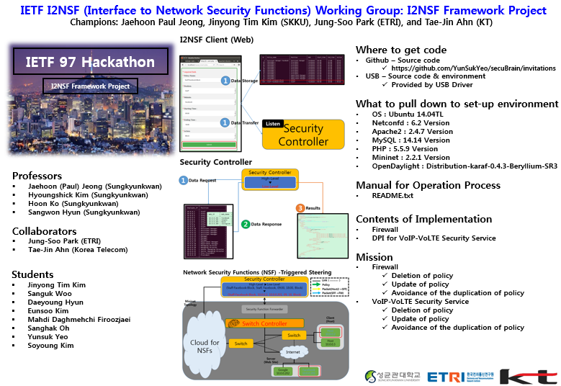
Introduction (1/3)
Introduction
I2NSF Framework for provisioning Network Security Functions (NSFs).
Firewall in I2NSF Framework using Software-Defined Networking (SDN).
Deep Packet Inspection (DPI) for VoIP/VoLTE Security Service in I2NSF Framework.

Slide 3
Introduction (2/3)
Working Group Drafts
https://tools.ietf.org/html/draft-ietf-i2nsf-framework-04
https://tools.ietf.org/html/draft-hares-i2nsf-capability-data-model-00
https://tools.ietf.org/html/draft-kim-i2nsf-nsf-facing-interface-data-model-00
https://tools.ietf.org/html/draft-jeong-i2nsf-sdn-security-services-05
https://tools.ietf.org/html/draft-kim-i2nsf-security-management-architecture-03
https://tools.ietf.org/html/draft-kim-i2nsf-consumer-facing-interface-dm-00
https://tools.ietf.org/html/draft-hyun-i2nsf-nsf-triggered-steering-00
https://tools.ietf.org/html/draft-hyun-i2nsf-registration-interface-im-00
https://tools.ietf.org/html/draft-ahn-i2nsf-communications-security-use-case-01

Slide 4

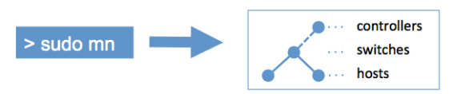




Introduction (3/3)
Build Environment
OS
Ubuntu 14.04TL
Netconfd
6.2 Version
Apache2
2.4.7 Version
MySQL
14.14 Version
PHP
5.5.9 Version
Mininet
2.2.1 Version
OpenDaylight
Distribution-karaf-0.4.3-Beryllium-SR3

Slide 5
Architecture (1/3)
I2NSF Consummer
Time-dependent
Ex) 09:00 – 12:00 => Block
12:00 – 13:00 => Unblock
Security Controller
NSF1
(Firewall)
SFF
NSF2
(DPI)
Security Controller
Facebook
10.1.1.10
Host
10.0.0.1
(Employee)
Internet
Switch
Switch
Switch
Switch
Switch
Switch
Youtube
10.2.1.20
Hacker
Africa

Slide 6
Architecture (2/3)
Policy Name:
Staff-Facebook-Block
▼
Position:
Staff
▼
Website:
Facebook
▼
I2NSF Consumer (Web)
Starting Time:
09:00
▼
Ending Time:
▼
18:00
Action:
Block
▼
Submit
Rest API
1
High Level Policy
Listen
High-Level ▶Low-Level
(Staff-Facebook-Block, Staff, Facebook, 09:00, 18:00, Block)
▼
(Staff-Facebook-Block, 10.0.0.2, 10.0.0.201, 09, 18, Block)
Security Controller

Slide 7




Architecture (3/3)
https://tools.ietf.org/html/draft-ietf-i2nsf-framework-04
https://tools.ietf.org/html/draft-jeong-i2nsf-sdn-security-services-05
Listen
High-Level ▶Low-Level
(Staff-Facebook-Block, Staff, Facebook, 09:00, 18:00, Block)
▼
(Staff-Facebook-Block, 10.0.0.2, 10.0.0.201, 09, 18, Block)
Security Controller
NETCONF/
YANG
Firewall
Security Function Forwarder
DDoS Mitigation
Security Functions
Valid packets
Switch Controller
Invalid packets
Switch₁
Switch₂
Incoming packets
Outgoing packets
Switch₃

Slide 8
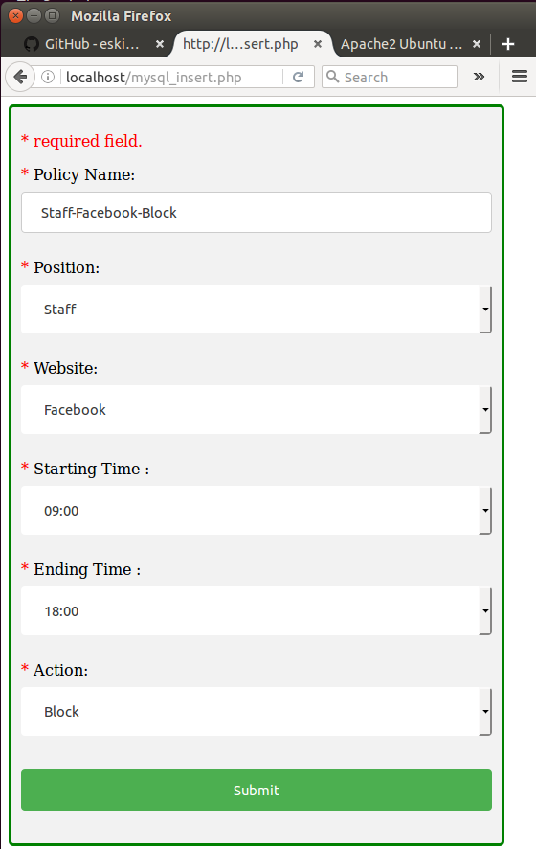
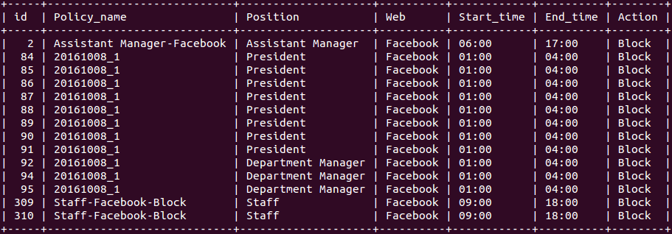
Implementation for Firewall (1/4)
I2NSF Consumer (Web)
1
Data Storage
310, Staff-Facebook-Block, Staff, Facebook, 09:00, 18:00, Block
1
Data Transfer
Listen
Security
Controller
Notes:
Slide 25 : Implementation of VoIP/VoLTE (proceeding) (1/5)
The following is the result still being implemented in relation to this subject.
It was performed to implement divied into three area.
The First area is I2NSF Client (Web).
This area receives a high-level data from the user and administrator functions to deliver to the Security Controller.
The sequence of operations is as follows.
Number 1. Administrator has set up a Policy Name, Position, Website, Starting Time, Ending Time and Action on the Web.
Number 2. It is stored in the set information in the database. At the same time it is transmitted to the Security Controller.
Number 3. The Security Controller is brought to request the data in the database.

Slide 9
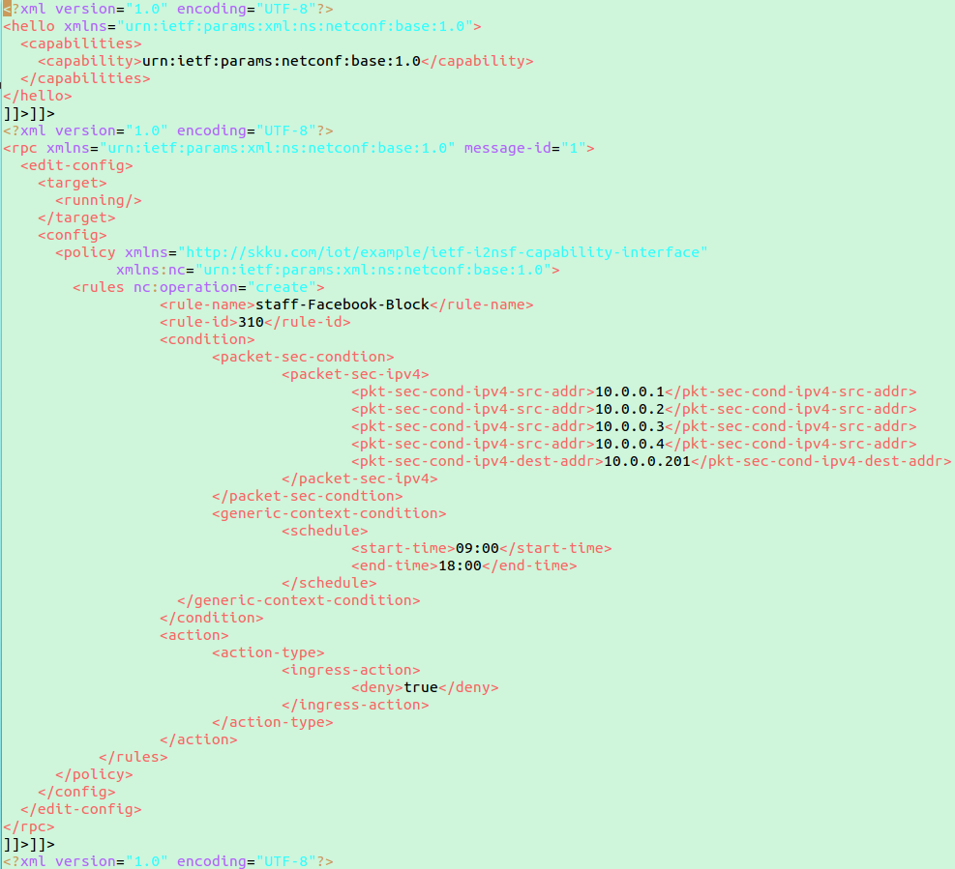
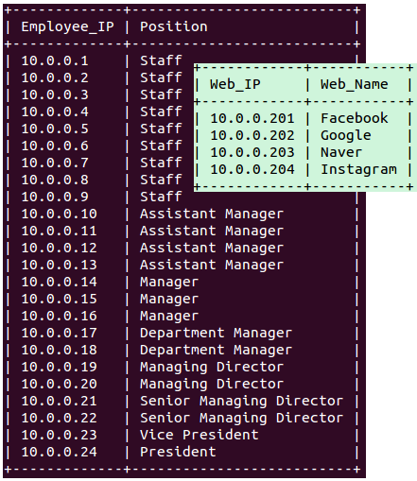
Implementation for Firewall (2/4)
Security Controller
Security Controller
2
Data Request
High-Level
▼
Low-Level
https://tools.ietf.org/html/draft-kim-i2nsf-nsf-facing-interface-data-model-00
3
Results
2
Data Response
Notes:
Slide 26 : Implementation of VoIP/VoLTE (proceeding) (2/5)
The following is a Security Controller.
Number 1. Security Controller matched the data is imported via the Position Database and Web Database.
Number 2. Security Controller will change the data obtained from the I2NSF Client (Web) from a High-Level and Low-Level.
Number 3. The low-level data is to be changed to xml file for YANG structure.

Slide 10

Implementation for Firewall (3/4)
Network Security Functions (NSF) -Triggered Steering
Security Controller
Link ( )
High-Level ▶Low-Level
(Staff-Facebook-Block, Staff, Facebook, 09:00, 18:00, Block)
▼
(Staff-Facebook-Block, 10.0.0.2, 10.0.0.201, 09, 18, Block)
Policy
Mininet Topology
Packet(Host2->SFF)
Packet(SFF->FW)
Security Function Forwarder
Client
(Host)
Switch Controller
Switch
Host
10.0.0.2
Cloud for NSFs
Switch
Host
10.0.0.3
Internet
Server
(Web Site)
Google
10.0.0.202
Facebook
10.0.0.201
Notes:
Slide 27 : Implementation of VoIP/VoLTE (proceeding) (3/5)
The following is a Network Security Functions (NSF) configuring the set Switch Controller, Security Controller, Security Funcion Forwarder, Switch and Host in Mininet Topology.
Host was composed of Cloud for NSFs, Client and Web Site Server.

Slide 11
Implementation for Firewall (4/4)
Network Security Functions (NSF) -Triggered Steering
Security Controller
Link ( )
High-Level ▶Low-Level
(Staff-Facebook-Block, Staff, Facebook, 09:00, 18:00, Block)
▼
(Staff-Facebook-Block, 10.0.0.2, 10.0.0.201, 09, 18, Block)
Policy
Mininet Topology
Packet(Host2->SFF)
Packet(SFF->FW)
Cloud for NSFs
Security Function Forwarder
https://tools.ietf.org/html/draft-hyun-i2nsf-nsf-triggered-steering-00
Client
(Host)
Switch Controller
Block
Firewall
Switch
Host
10.0.0.2
DPI
Switch
Host
10.0.0.3
DDoS-attack mitigation
Internet
VoIP/VoLTE
Server
(Web Site)
Google
10.0.0.202
Facebook
10.0.0.201
Notes:
Slide 28 : Implementation of VoIP/VoLTE (proceeding) (4/5)
Number 1. The policy is forwarded from Security Controller to Firewall, So the policy on the Firewall is entered.
Number 2. In attempts to connect Host 2 to Facebook.
Number 3. The packet is transmitted for connect.
Number 4. By default, The packet via the Switch Controller, is sent to the Security Function Forwarder (SFF).
Number 5. Security Function Forwarder (SFF) is looking to the packet sent to the Firewall.
Number 6. However, since the input Firewall policy to the packet it is to be Block.
This implementation is considered to be able to be useful in various companies and organizations.

Slide 12
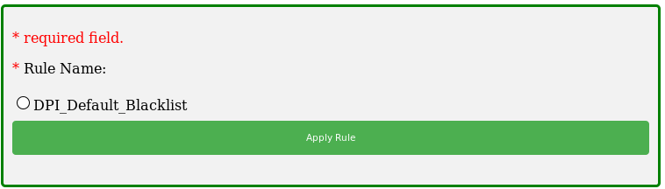
Implementation for DPI (1/4)
I2NSF Consumer (Web)
1
Data Transfer
Security
Controller
Listen
Notes:
Slide 25 : Implementation of VoIP/VoLTE (proceeding) (1/5)
The following is the result still being implemented in relation to this subject.
It was performed to implement divied into three area.
The First area is I2NSF Client (Web).
This area receives a high-level data from the user and administrator functions to deliver to the Security Controller.
The sequence of operations is as follows.
Number 1. Administrator has set up a Policy Name, Position, Website, Starting Time, Ending Time and Action on the Web.
Number 2. It is stored in the set information in the database. At the same time it is transmitted to the Security Controller.
Number 3. The Security Controller is brought to request the data in the database.

Slide 13
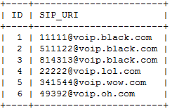
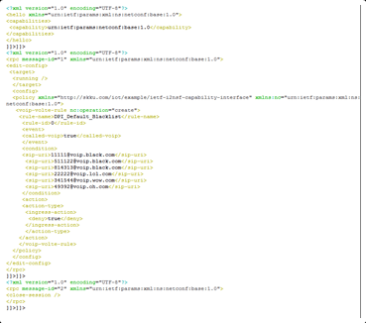
Implementation for DPI (2/4)
Security Controller
Security Controller
1
Data Request
High-Level
▼
Low-Level
https://tools.ietf.org/html/draft-kim-i2nsf-nsf-facing-interface-data-model-00
3
Results
2
Data Response
Notes:
Slide 26 : Implementation of VoIP/VoLTE (proceeding) (2/5)
The following is a Security Controller.
Number 1. Security Controller matched the data is imported via the Position Database and Web Database.
Number 2. Security Controller will change the data obtained from the I2NSF Client (Web) from a High-Level and Low-Level.
Number 3. The low-level data is to be changed to xml file for YANG structure.

Slide 14
Implementation for DPI (3/4)
Network Security Functions (NSF) -Triggered Steering
Security Controller
Link ( )
High-Level ▶Low-Level
(DPI_Default_Blacklist, event, Block)
▼
(DPI_Default_Blacklist, true, 11111@voip.black.com, Block)
Policy
Mininet Topology
Packet(Host2->SFF)
Packet(SFF->FW)
Security Function Forwarder
Client
(Host)
Switch Controller
Switch
Host
10.0.0.2
Cloud for NSFs
Switch
Host
10.0.0.3
Internet
Server
(Web Site)
Hacker
11111@voip.black.com
Notes:
Slide 27 : Implementation of VoIP/VoLTE (proceeding) (3/5)
The following is a Network Security Functions (NSF) configuring the set Switch Controller, Security Controller, Security Funcion Forwarder, Switch and Host in Mininet Topology.
Host was composed of Cloud for NSFs, Client and Web Site Server.

Slide 15
Implementation for DPI (4/4)
Network Security Functions (NSF) -Triggered Steering
Security Controller
Link ( )
High-Level ▶Low-Level
(DPI_Default_Blacklist, event, Block)
▼
(DPI_Default_Blacklist, true, 11111@voip.black.com, Block)
Policy
Mininet Topology
Packet(Host2->SFF)
Packet(SFF<->FW)
Cloud for NSFs
Security Function Forwarder
https://tools.ietf.org/html/draft-hyun-i2nsf-nsf-triggered-steering-00
Client
(Host)
Switch Controller
VoIP
Firewall
Switch
Host
10.0.0.2
Block
DPI
Switch
Host
10.0.0.3
DDoS-attack mitigation
Internet
VoIP/VoLTE
Server
(Web Site)
Hacker
11111@voip.black.com
Notes:
Slide 28 : Implementation of VoIP/VoLTE (proceeding) (4/5)
Number 1. The policy is forwarded from Security Controller to Firewall, So the policy on the Firewall is entered.
Number 2. In attempts to connect Host 2 to Facebook.
Number 3. The packet is transmitted for connect.
Number 4. By default, The packet via the Switch Controller, is sent to the Security Function Forwarder (SFF).
Number 5. Security Function Forwarder (SFF) is looking to the packet sent to the Firewall.
Number 6. However, since the input Firewall policy to the packet it is to be Block.
This implementation is considered to be able to be useful in various companies and organizations.

Slide 16
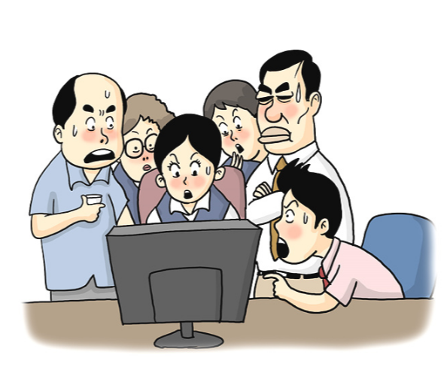


Scenario for Firewall (1/9)
Firewall
Employees often access the SNS during working time.
The president thinks that accessing the SNS is inefficient during working time.
Therefore, the president want to block that employees access the SNS during working time.

Slide 17
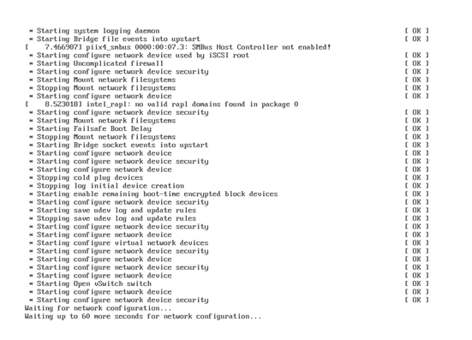
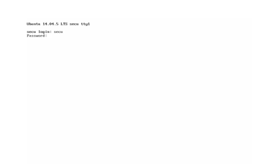
Scenario for Firewall (2/9)
Firewall
VMware Workstation starts.
Login.

Slide 18
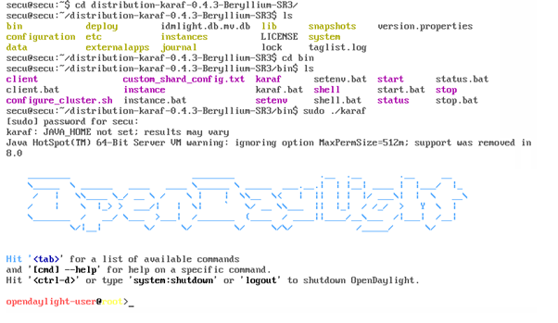
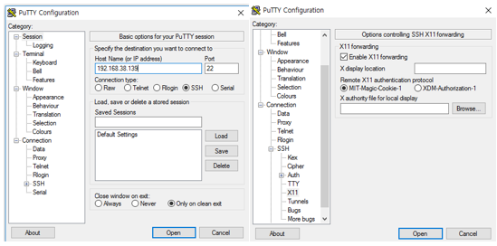
Scenario for Firewall (3/9)
Firewall
Move to OpenDaylight directory and start SDN controller.
Connect to the SSH through Putty program and enable X display.

Slide 19
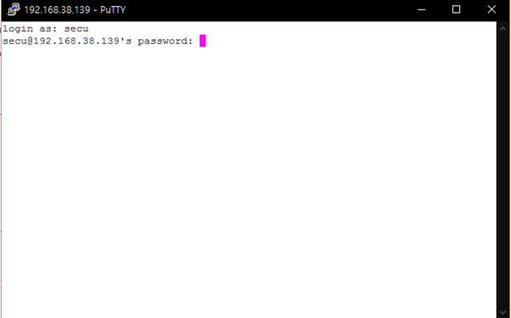
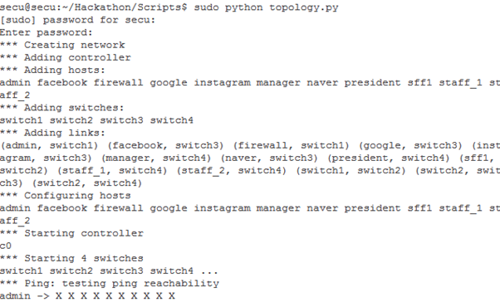
Scenario for Firewall (4/9)
Firewall
Login to connect the putty.
Start mininet topology.

Slide 20
Scenario for Firewall (5/9)
Mininet Topology
SFF
Switch 1
Staff_1
NSF1
(Firewall)
Staff_2
Switch 4
Switch 2
Manager
NSF2
(DPI)
President
Switch 3
Pkt_gen
Google
Facebook

Slide 21
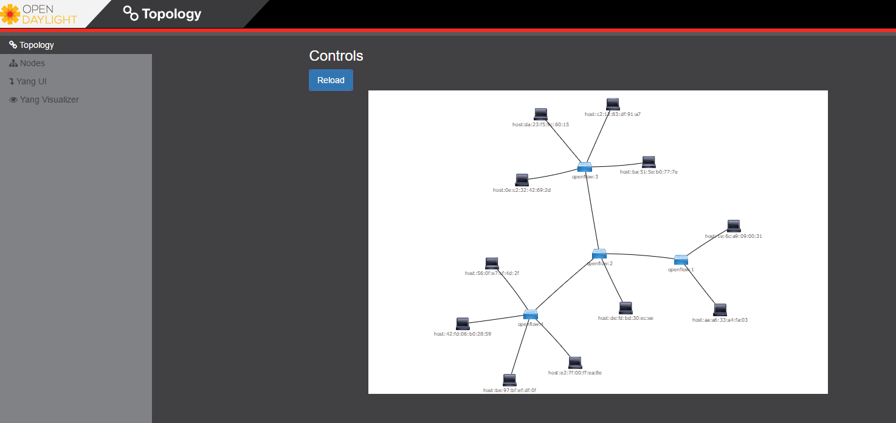
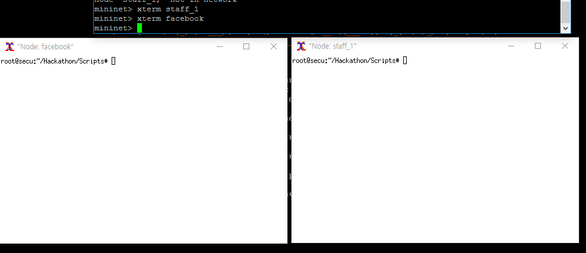
Scenario for Firewall (6/9)
Firewall
Mininet topology GUI supported on OpenDaylight (https://localhost/index.html).
Open the Xterm for each component (ex. Staff and facebook).

Slide 22
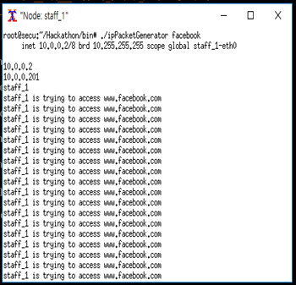
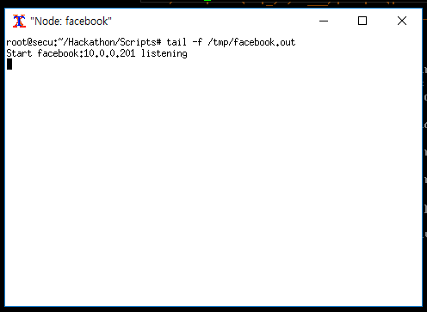
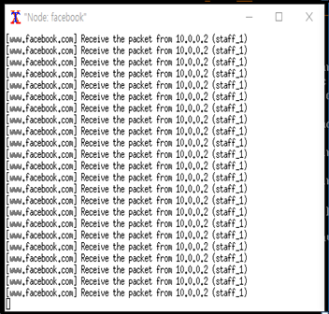
Scenario for Firewall (7/9)
Firewall
Show the incoming packet log to Facebook.
Staff sends a packet to Facebook.

Slide 23
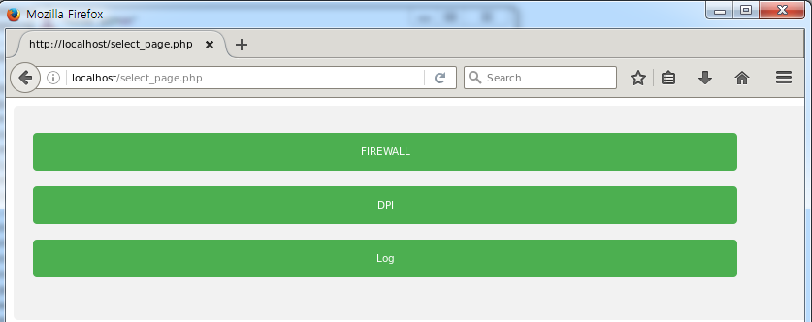
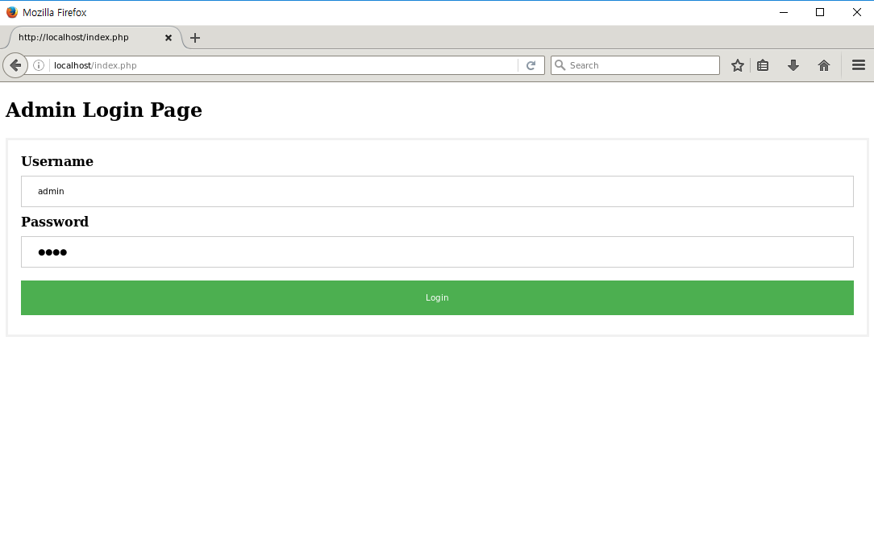
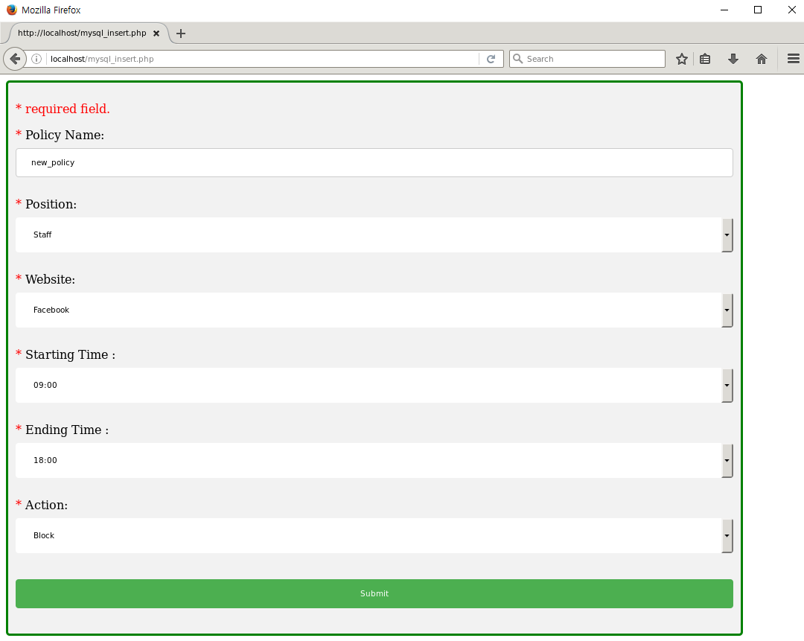
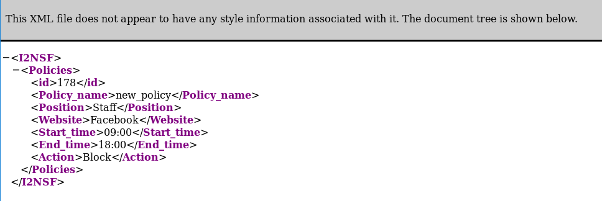
Scenario for Firewall (8/9)
Firewall
Open Policy setup web page through Firefox (http://localhost.index.php).

Slide 24
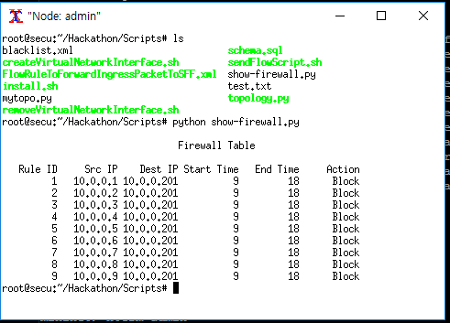
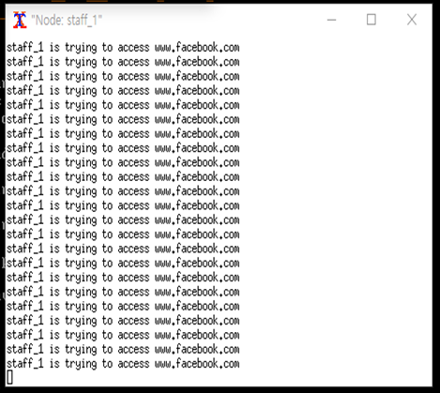
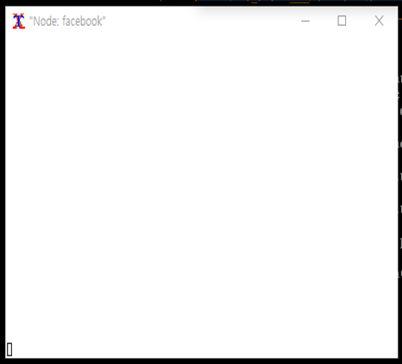
Scenario for Firewall (9/9)
Firewall
Check the firewall policy set at admin.
Check the blocked packet to Facebook from staff through log.

Slide 25




Scenario for DPI (1/11)
VoIP/VoLTE
The company uses KT service.
Hackers attack employees of the company.
However, the company can block the packets of hackers using DPI for VoIP/VoLTE based on SDN/NFV.
User Agent
SIP URI
Hacker A
Hacker B

Slide 26
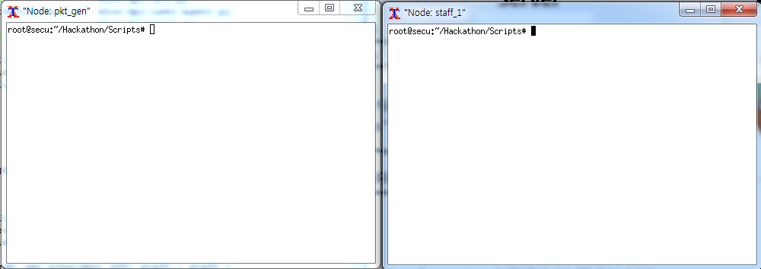
Scenario for DPI (2/11)
VoIP/VoLTE
1. Processes are equal to firewall scenario processes from 1 to 6.
2. Open the Xterm for each component (e.g., pkt_gen and staff_1).

Slide 27
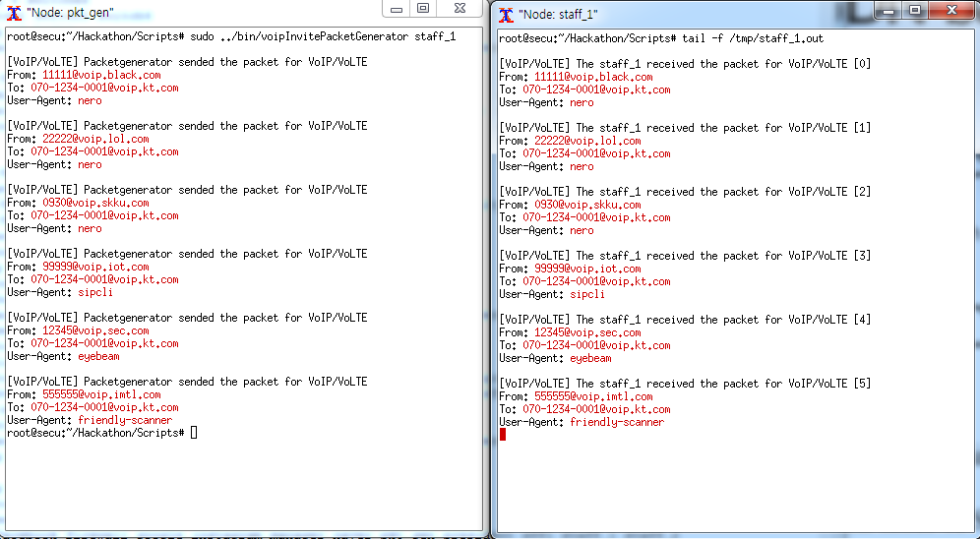
Scenario for DPI (3/11)
VoIP/VoLTE
3. pkt_gen can send various malicious packets for VoIP/VoLTE.
4. pkt_gen sends various malicious packets to the staff_1.

Slide 28
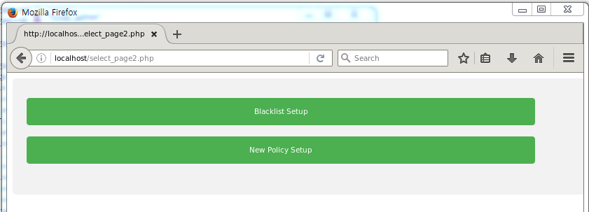
Scenario for DPI (4/11)
VoIP/VoLTE
5. Open Policy setup web page through Firefox (http://localhost.index.php).

Slide 29
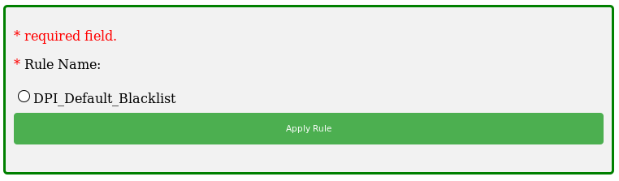
Scenario for DPI (5/11)
VoIP/VoLTE
6. We can set the policy for blocking malicious VoIP/VoLTE packets through three methods.
6.1. Set up default blacklist using known blacklist.

Slide 30
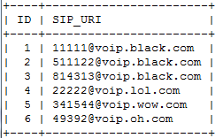
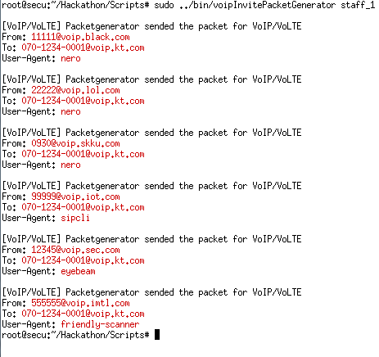
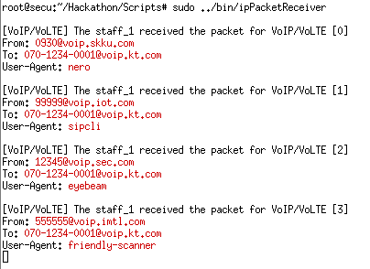
Scenario for DPI (6/11)
VoIP/VoLTE
6. We can set the policy for blocking malicious VoIP/VoLTE packets through three methods.
6.1. Set up using known blacklist.

Slide 31
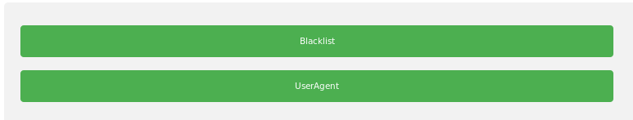
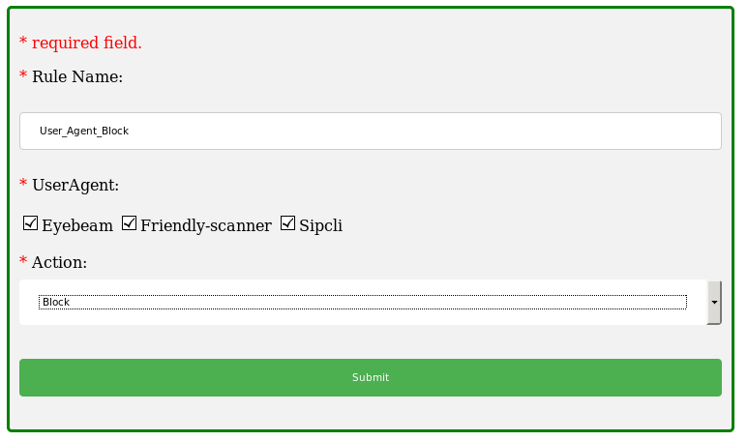
Scenario for DPI (7/11)
VoIP/VoLTE
6. We can set the policy for blocking malicious VoIP/VoLTE packets through three methods.
6.2. Set up a new policy using user agent.

Slide 32
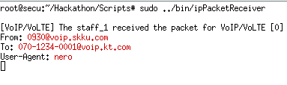
Scenario for DPI (8/11)
VoIP/VoLTE
6. We can set the policy for blocking malicious VoIP/VoLTE packets through three methods.
6.2. Set up a new policy using user agent.

Slide 33
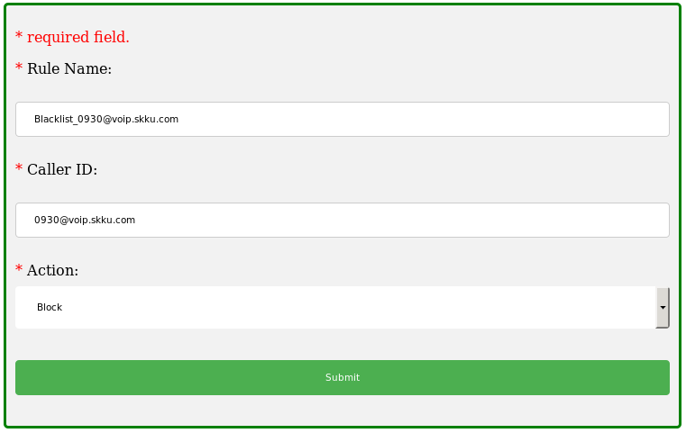
Scenario for DPI (9/11)
VoIP/VoLTE
6. We can set the policy for blocking malicious VoIP/VoLTE packets through three methods.
6.3. Set up a new policy using SIP URI.

Slide 34

Scenario for DPI (10/11)
VoIP/VoLTE
6. We can set the policy for blocking malicious VoIP/VoLTE packets through three methods.
6.3. Set up a new policy using SIP URI.

Slide 35
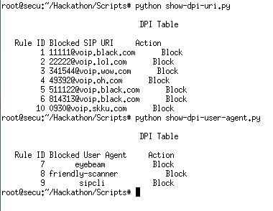
Scenario for DPI (11/11)
VoIP/VoLTE
7. Check the DPI policy set at administrator.

Slide 36
Mission in Hackathon
DPI for VoIP/VoLTE
I2NSF Consumer
Data transfer to security controller.
Security Controller
Translation from a high-level policy to a low-level policy.
YANG data model design for firewall policy.
Implementation network configuration (NETCONF).
Network Security Functions & Security Function Forwarder
Implementation DPI for VoIP/VoLTE.

